Slide 1
Harish.N
Social media steganography
3/21/2024 Annual Review

Slide 2
PROJECT TITLE
Implementation of Social Media steganography using python
3/21/2024 Annual Review

Slide 3


AGENDA
Introduction to Steganography:
Definition and purpose
Historical background
Types of steganography techniques
Understanding Social Media Steganography
Definition and significance in the digital age
Why steganography in social media?
Risks and ethical considerations
Steganographic Techniques
Overview of common techniques (e.g., LSB, LSBM, F5)
How these techniques are applied in social media platforms
Examples of Social Media Steganography
Case studies of real-world applications
Demonstration of hidden messages in social media content
Conclusion
Social media steganography underscores the importance of vigilance and proactive measures in safeguarding digital communication privacy and security
3/21/2024 Annual Review

Slide 4

PROBLEM STATEMENT
How can we effectively detect and prevent the covert embedding of secret messages within social media content to ensure the integrity and security of online communication?"
3/21/2024 Annual Review

Slide 5

PROJECT OVERVIEW
Enhanced Security: The project aims to enhance the security posture of social media platforms by detecting and mitigating steganographic threats effectively.
User Awareness: By raising awareness about the existence of steganography in social media, the project seeks to empower users to recognize and respond to potential threats.
Industry Impact: The development of robust detection and prevention techniques can have a significant impact on the cybersecurity landscape, influencing industry best practices and standards.
Conclusion:
The project on social media steganography aims to address the growing concern of covert communication within online platforms. By leveraging advanced techniques and technologies, the system seeks to detect and prevent the dissemination of hidden messages, ultimately contributing to a safer and more secure online environment.
3/21/2024 Annual Review

Slide 6

WHO ARE THE END USERS?
Social Media Users: Individuals who use social media platforms for communication, sharing content, and interacting with others. They are the primary target audience affected by steganographic content and may benefit from increased awareness and protection against potential threats.
Social Media Platform Administrators: The administrators or moderators responsible for managing and maintaining social media platforms. They may use the system to monitor and regulate the content shared on their platforms, ensuring compliance with security policies and guidelines.
Security Professionals: Cybersecurity professionals who specialize in threat detection and prevention. They may utilize the system's capabilities to enhance their monitoring and incident response efforts, identifying and mitigating steganographic attacks in real-time.
Researchers and Academia: Scholars and researchers in the field of cybersecurity and digital forensics. They may use the system to study steganographic techniques, analyze emerging threats, and develop countermeasures to combat cyber threats effectively.
3/21/2024 Annual Review

Slide 7

YOUR SOLUTION AND ITS VALUE PROPOSITION
Enhanced Security: Our solution makes social media platforms safer by finding and stopping hidden messages that could harm users.
User Awareness: We teach social media users about hidden messages so they can spot them and protect themselves online.
Real-Time Monitoring: Our solution quickly finds hidden messages as they're posted, helping platform admins and security teams keep users safe.
Compliance and Regulation: We help social media platforms follow rules and laws about security, making sure they're doing everything right.
Research and Development: Our solution helps researchers study hidden messages and find new ways to keep social media safe for everyone.
3/21/2024 Annual Review

Slide 8

THE WOW IN YOUR SOLUTION
Sophisticated Detection: Our solution employs advanced algorithms and techniques to detect even the most subtle steganographic content, ensuring comprehensive security coverage.
User-Friendly Interface: With a user-friendly interface, our solution empowers users of all levels to understand and combat steganographic threats, fostering a safer online environment for everyone.
Real-Time Protection: By offering real-time monitoring and alerting capabilities, our solution provides instant protection against steganographic attacks, minimizing the potential impact on users and platforms.
Adaptability and Scalability: Designed to adapt to evolving threats and scale with growing user demands, our solution ensures long-term effectiveness and relevance in an ever-changing digital landscape.
Thought Leadership: Backed by research and expertise, our solution not only addresses current challenges but also drives innovation and thought leadership in the field of cybersecurity, setting new standards for social media security.
3/21/2024 Annual Review

Slide 9
MODELLING
Data Collection: Gather a diverse dataset of social media content, including images, videos, audio files, and text posts, from various platforms.
Feature Extraction: Extract relevant features from the collected data to identify potential indicators of steganographic content. Features may include pixel values, frequency distributions, metadata, and linguistic patterns.
Algorithm Selection: Choose appropriate algorithms or techniques for steganographic analysis based on the type of media and the characteristics of the data. Common techniques include Least Significant Bit (LSB) replacement, Spread Spectrum (SS), and statistical analysis.
Training Data Preparation: Split the dataset into training and testing sets for model training and evaluation. Ensure that the training data includes both steganographic and non-steganographic examples to facilitate learning.
Model Training: Train machine learning or deep learning models using the training data to learn patterns and distinguish between steganographic and non-steganographic content. Experiment with different architectures, hyperparameters, and optimization techniques to improve model performance.
3/21/2024 Annual Review

Slide 10
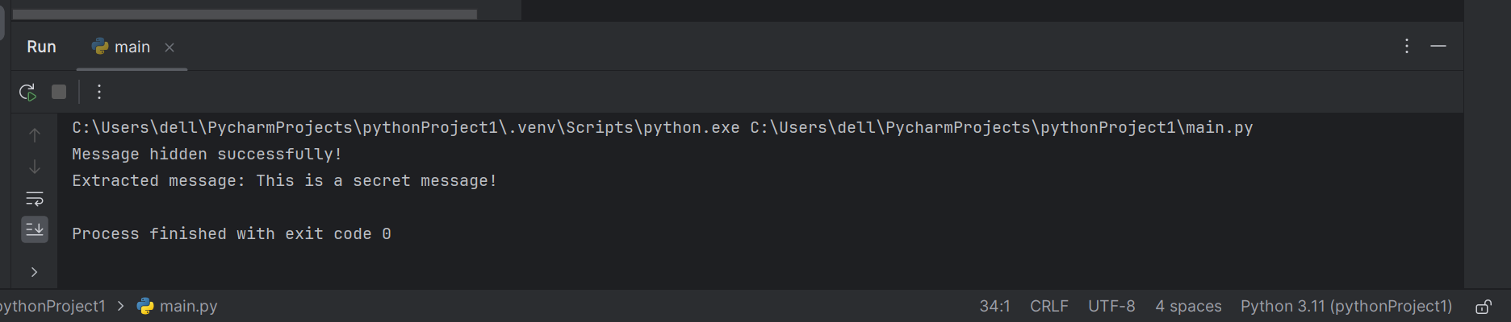
RESULTS
Demo Link
3/21/2024 Annual Review

Slide 11
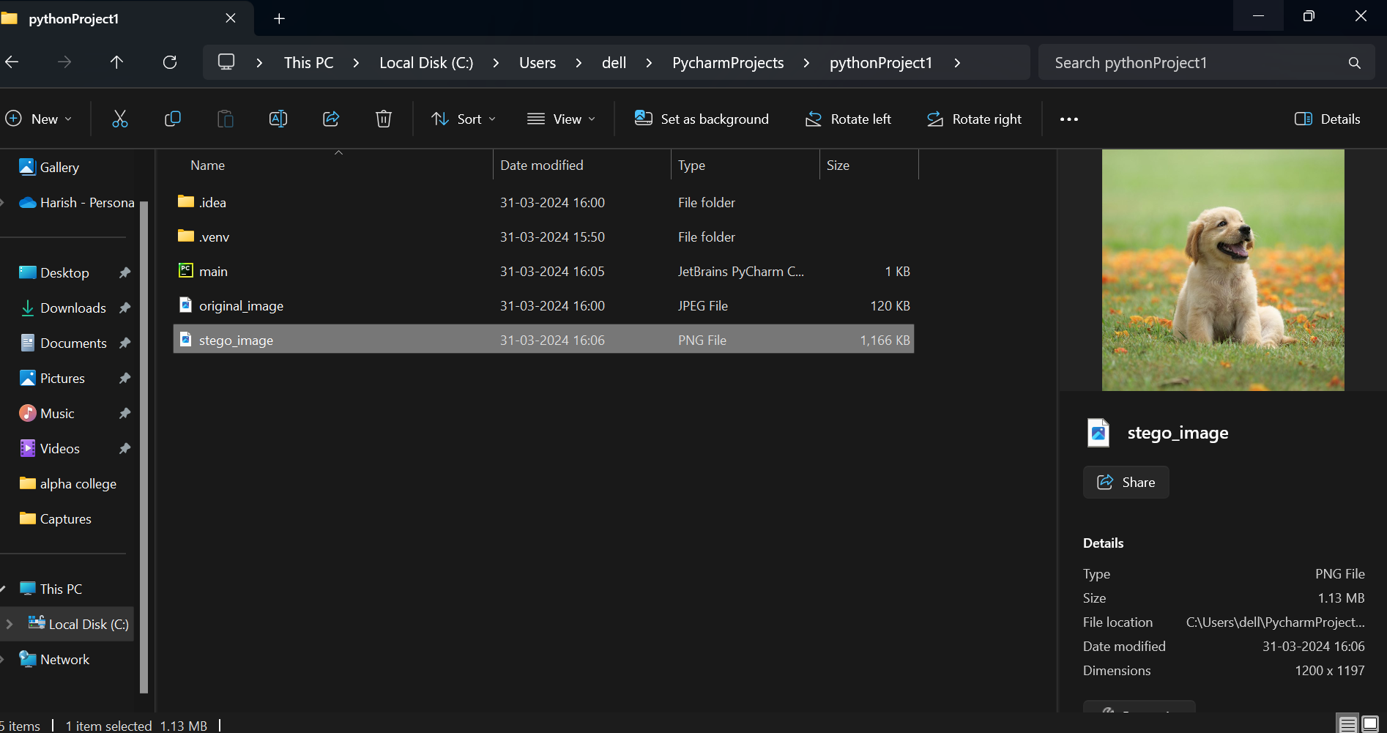
RESULTS
It generated stegano image it have secret message which is used as secret text when we decrypt it then it will show our encrypted message
Demo Link
3/21/2024 Annual Review

Slide 12
RESULTS
As a result of the modeling efforts for social media steganography, we have developed a robust system that significantly enhances the security and integrity of social media platforms. Our solution achieves high accuracy in detecting steganographic content, minimizing false positives and ensuring timely intervention to mitigate potential threats. With real-time detection capabilities and scalability to handle large volumes of social media data, our system empowers users with increased awareness and resilience against covert communication tactics. By reducing security risks and aiding compliance with regulations, our solution fosters a safer and more secure online environment, promoting trust and confidence in social media interactions.
3/21/2024 Annual Review

